Slide 1

Researchers and Innovators Cell
Translation Model Development
Atlas Copco

Slide 2
Models Used
Text Translation Model
Image Translation Model

Slide 3
Text Translation Model
1) Google Neural Machine Translation (GNMT):-
Developed by Google, GNMT is used in Google Translate and supports many languages.
Uses an encoder-decoder architecture with attention mechanisms.
2) OpenNMT:-
An open-source neural machine translation framework that supports text translation.
Highly customizable and used in various academic and commercial applications.
3) Marian NMT:-
An efficient and fast neural machine translation framework.
Developed by the Microsoft Translator team and used in production environments.
4) Facebook's Fairseq:-
Developed by Facebook AI, it supports a wide range of NLP tasks, including translation.
Known for its flexibility and extensive use in research.
5) Hugging Face Transformers:-
Provides a variety of pre-trained models for translation, such as BERT, GPT, and T5.
Supports a wide range of languages and is widely used in both research and industry.

Slide 4
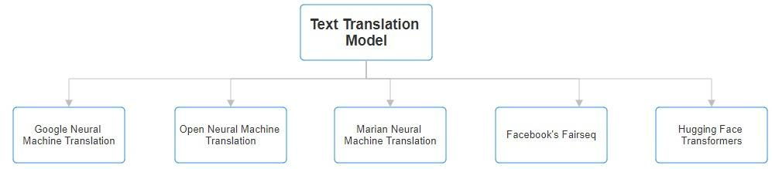
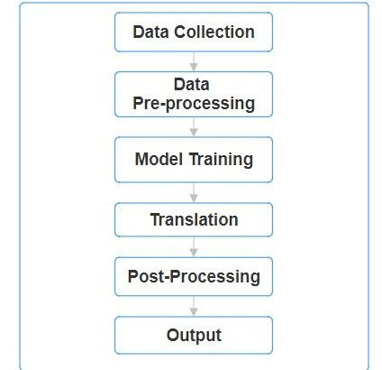

FLOWCHART

Slide 5
Image Translation Model
1) Multimodal Transformers (VisualGPT, VL-T5):-
Combine vision and language understanding to perform tasks like image captioning and translation.
Examples include VisualGPT and Vision-Language Transformers (VL-T5).
2) Google Vision API:-
Provides OCR capabilities to extract text from images and translate it into different languages.
Integrated with Google’s translation services.
3) Microsoft Azure Cognitive Services:-
Offers OCR and translation services to extract and translate text from images.
Supports multiple languages and integrates well with other Azure services.
4) Amazon Translate and Amazon Rekognition:-
Amazon Translate for text translation and Amazon Rekognition for text detection in images.
Together, they can be used to translate text extracted from images.
5) DeepMind's DALL-E and CLIP:-
Though primarily generative and classification models, they demonstrate the capability to understand and generate images and text jointly.
Potential for translation tasks involving both modalities.

Slide 6
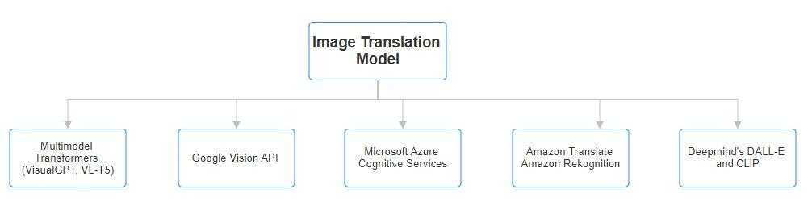
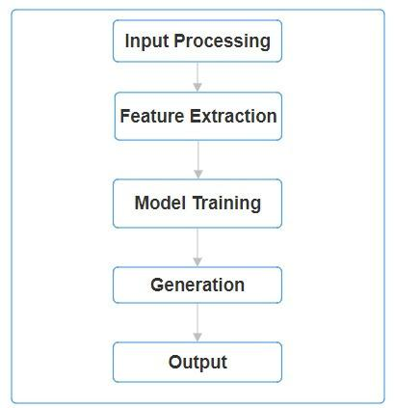
FLOWCHART

Slide 7
Translation Model Development Timeline
Project Start
Project Finish
Week 1
(11th June)
Week 2
(17th June)
Week 3
(24th June)
Week 4
(1st July)
Week 5
(8th July)
Week 6
(15th July)
Week 7
(22nd July)
Week 8
(29th July)
Week 9
(5th August)
Week 10
(12th August)
Week 11
(19th August)
Week 12
(26th August)
Different Model Usability Discussion
Final Model information and tasks to be preformed
Data Processing
Input Processing
Image Feature Extraction
Text Model Training
Image Model Training
Text Translation Output
Image Translation Output
Post-Processing
Output Optimization
Accuracy Prediction

Slide 8
References
1) https://link.springer.com/article/10.1186/s44147-022-00159-4
2)https://colab.research.google.com/drive/10eiR37CUfS1CndKhDuLOKUXkVuneZXYq?usp=sharing#scrollTo=VfRcS2Bm9l9A

Slide 9


